Slide 1
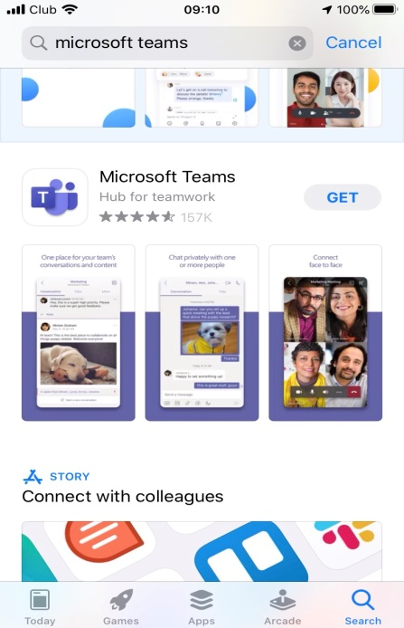
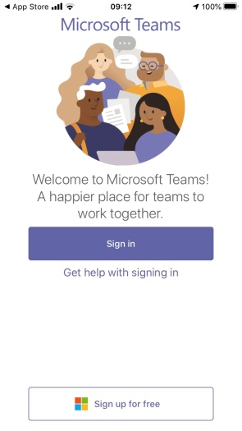
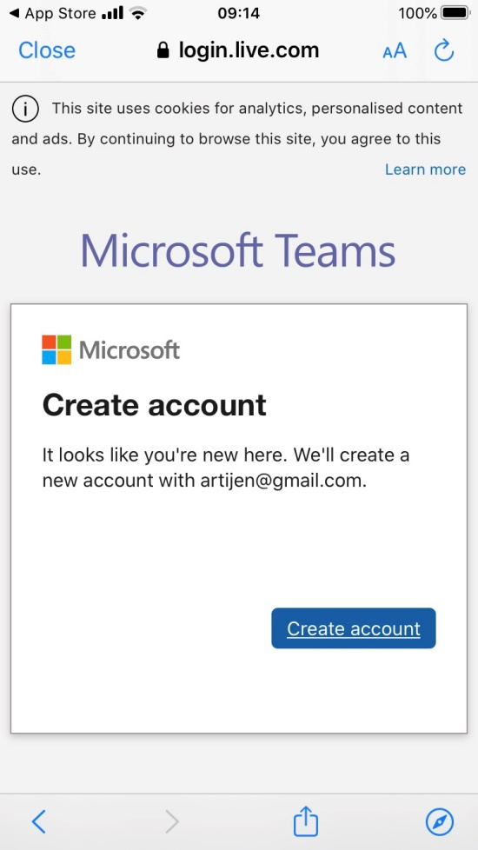
Instructions on how to download Microsoft Teams
Go to your app store on your smartphone or tablet
You can download the software from your internet browser on a computer
If you do not have a Microsoft live account you will need to register and sign up for free. Create an account.

Slide 2
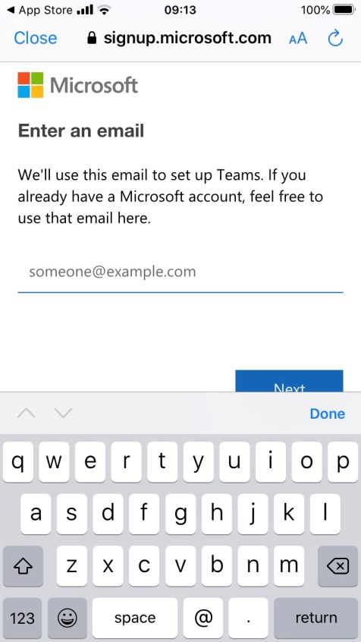
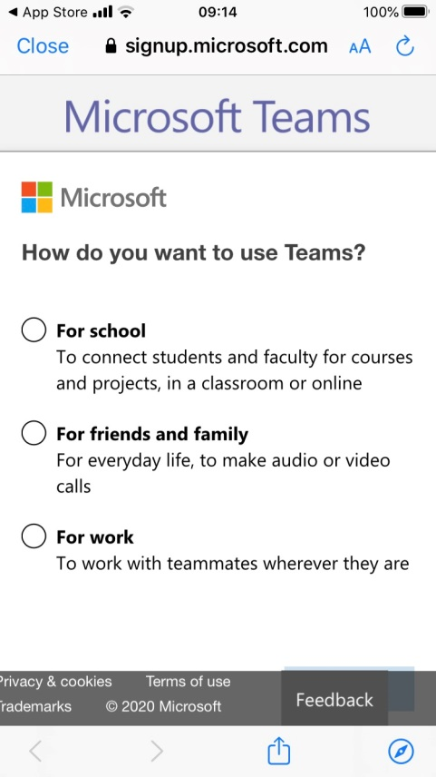
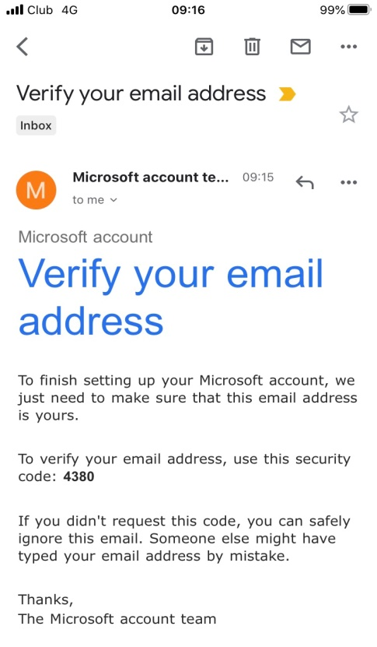
Enter your email. Make sure you do this correctly with no mistakes
Click next and choose the work option.
You will be sent an email with a 4 digit code you will need to insert into a box
***
****

Slide 3
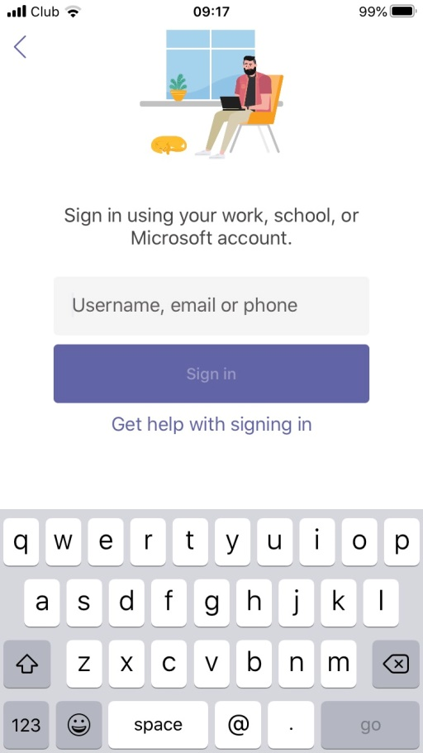
Last few details…..
Sign in using your email and password you have created for Microsoft Teams
Click on the link in the email sent to you
Hi
Please click on the link to join us for the Recovery College Course
Join Microsoft Teams Meeting
Example time/date only: On Tuesday 12th May at 10am
Please join a few minutes before the start so we can start on time with everyone online.
We look forward to seeing you then.
Recovery College South West Yorkshire Partnership NHS Foundation Trust

